Slide 1
Graph
COMP171
Fall 2005

Slide 2
Graphs
Extremely useful tool in modeling problems
Consist of:
  Vertices
  Edges
Vertices can be
considered “sites”
or locations.
Edges represent
connections.
D
E
C
A
F
B
Vertex
Edge

Slide 3
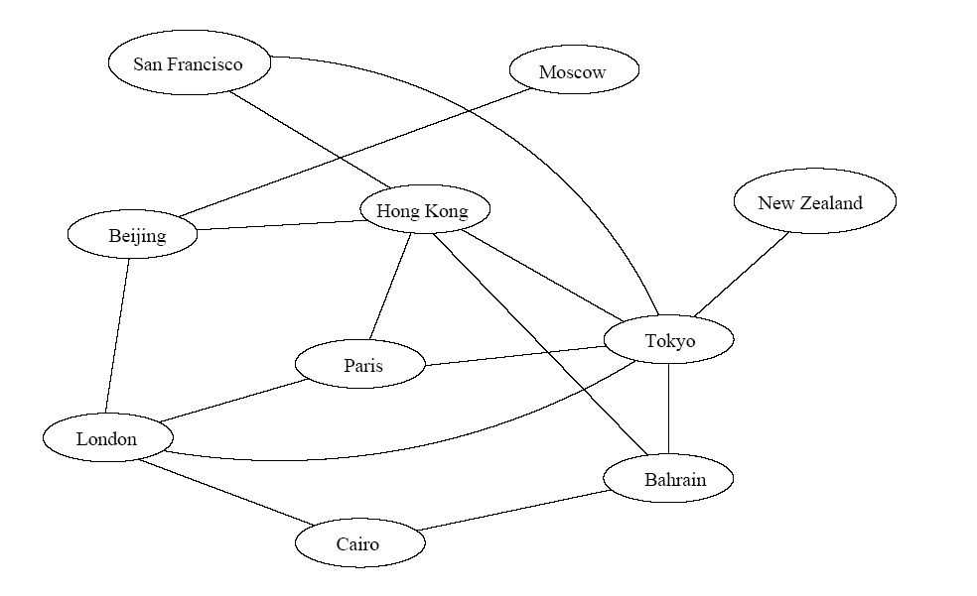
Applications
Air flight system
Each vertex represents a city
Each edge represents a direct flight between two cities
A query on direct flights becomes a query on whether an edge exists
A query on how to get to a location is “does a path exist from A to B”
We can even associate costs to edges (weighted graphs), then ask “what is the cheapest path from A to B”

Slide 4
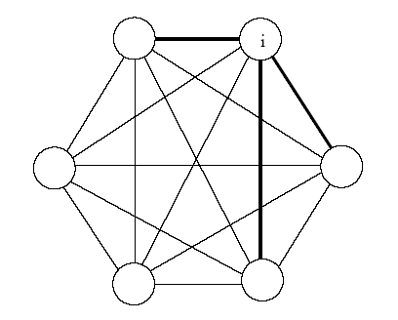
Another application
Wireless communication
Can be represented by a weighted complete graph (every two vertices are connected by an edge).
Each edge represents the Euclidean distance dij between two stations.
Each station uses a certain power i to transmit messages. Given this power i, only a few nodes can be reached (bold edges). A station reachable by i then use its own power to relay the message to other stations not reachable by i.
A typical wireless communication problem is: how to broadcast between all
stations such that they are all connected and the power consumption
is minimized.

Slide 5
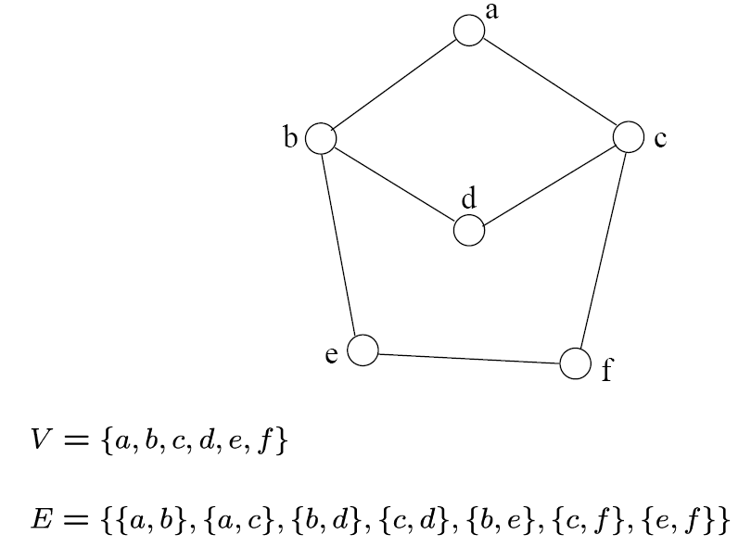
Definition
Undirected graph
  An undirected graph is specified by an ordered pair (V,E), where V is the set of vertices and E is the set of edges
{a,b}
{a,c}
{b,d}
{c,d}
{b,e}
{c,f}
{e,f}

Slide 6
Terminology
If v₁ and v₂ are connected, they are said to be adjacent vertices
    v₁ and v₂ are endpoints of the edge {v₁, v₂}
If an edge e is connected to v, then v is said to be incident on e. Also, the edge e is said to be incident on v.
{v₁, v₂} = {v₂, v₁}*
*Later, we will talk about “directed graphs”, where edges have direction. This
means that {v₁,v₂} ≠ {v₂,v₁} . Directed graphs are drawn with arrows (called arcs) between edges.
A
B
This means {A,B} only, not {B,A}

Slide 7
Graph Representation
Two popular computer representations of a graph. Both represent the vertex set and the edge set, but in different ways.
  Adjacency Matrix
    Use a 2D matrix to represent the graph
  Adjacency List
    Use a 1D array of linked lists

Slide 8
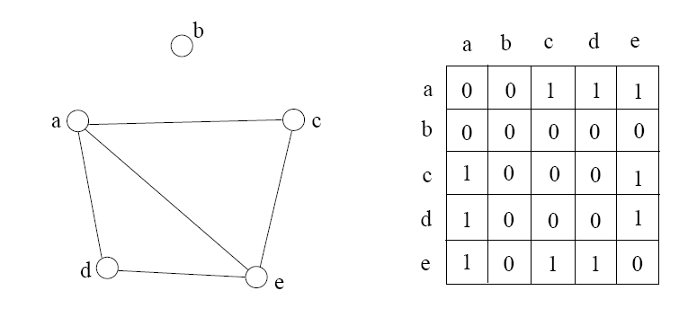
Adjacency Matrix
2D array A[0..n-1, 0..n-1], where n is the number of vertices in the graph
Each row and column is indexed by the vertex id.
  - e,g a=0, b=1, c=2, d=3, e=4
An array entry A [i] [j] is equal to 1 if there is an edge connecting
vertices i and j. Otherwise, A [i] [j] is 0.
The storage requirement is Θ(n²). Not efficient if the graph has few edges.
We can detect in O(1) time whether two vertices are connected.

Slide 9
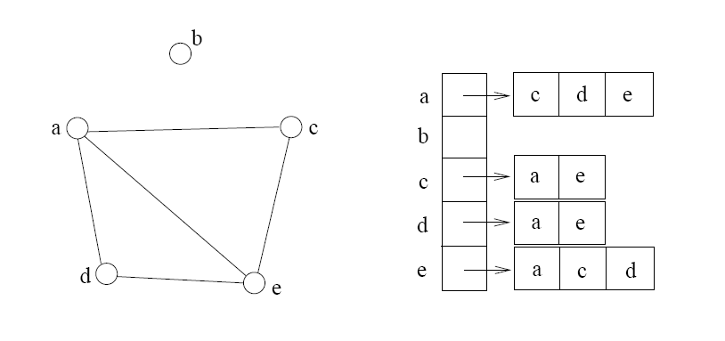
Adjacency list
The adjacency list is an array A[0..n-1] of lists, where n is the number of
vertices in the graph.
Each array entry is indexed by the vertex id (as with adjacency matrix)
The list A[i] stores the ids of the vertices adjacent to i.

Slide 10
Examples
0
 | 0 | 1 | 2 | 3 | 4 | 5 | 6 | 7 | 8 | 9
0 | 0 | 0 | 0 | 0 | 0 | 0 | 0 | 0 | 1 | 0
1 | 0 | 0 | 1 | 1 | 0 | 0 | 0 | 1 | 0 | 1
2 | 0 | 1 | 0 | 0 | 1 | 0 | 0 | 0 | 1 | 0
3 | 0 | 1 | 0 | 0 | 1 | 1 | 0 | 0 | 0 | 0
4 | 0 | 0 | 1 | 1 | 0 | 0 | 0 | 0 | 0 | 0
5 | 0 | 0 | 0 | 1 | 0 | 0 | 1 | 0 | 0 | 0
6 | 0 | 0 | 0 | 0 | 0 | 1 | 0 | 1 | 0 | 0
7 | 0 | 1 | 0 | 0 | 0 | 0 | 1 | 0 | 0 | 0
8 | 1 | 0 | 1 | 0 | 0 | 0 | 0 | 0 | 0 | 1
9 | 0 | 1 | 0 | 0 | 0 | 0 | 0 | 0 | 1 | 0
8
2
9
1
3
7
6
4
5

Slide 11
Examples
0
0
1
2
3
4
5
6
7
8
9
8
2 | 3 | 7 | 9
8
1 | 4 | 8
2
9
1 | 4 | 5
1
2 | 3
7
3 | 6
3
6
5 | 7
4
5
1 | 6
0 | 2 | 9
1 | 8

Slide 12
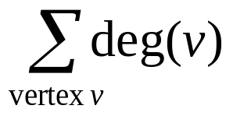
Storage of adjacency list
The array takes up Θ(n) space
Define degree of v, deg(v), to be the number of edges incident to v. Then, the total space to store the graph is proportional to:
An edge e={u,v} of the graph contributes a count of 1 to deg(u) and contributes a count 1 to deg(v)
Therefore, Σ_{vertex v}deg(v) = 2m, where m is the total number of edges
In all, the adjacency list takes up Θ(n+m) space.
  If m = O(n²), both adjacent matrix and adjacent lists use Θ(n²) space.
  If m = O(n), adjacent list outperform adjacent matrix
However, one cannot tell in O(1) time whether two vertices are connected.

Slide 13
Adjacency Lists vs. Matrix
Adjacency Lists
  More compact than adjacency matrices if graph has few edges
  Requires more time to find if an edge exists
Adjacency Matrix
  Always require n² space
    This can waste a lot of space if the number of edges are sparse
  Can quickly find if an edge exists

Slide 14
Types of paths
A path is simple if and only if it does not contain a vertex more than once.
A path is a cycle if and only if v₀= v_{k}
    The beginning and end are the same vertex!
A path contains a cycle if some vertex appears twice or more

Slide 15
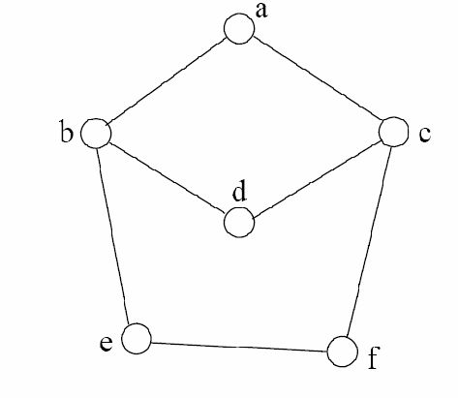
Examples
Are these paths?
Any cycles?
What is the path’s length?
{a,c,f,e}
{a,b,d,c,f,e}
{a, c, d, b, d, c, f, e}
{a,c,d,b,a}
{a,c,f,e,b,d,c,a}

Slide 16
Graph Traversal
Application example
  Given a graph representation and a vertex s in the graph
  Find all paths from s to other vertices
Two common graph traversal algorithms
    Breadth-First Search (BFS)
      Find the shortest paths in an unweighted graph
    Depth-First Search (DFS)
      Topological sort
      Find strongly connected components
Let’s first look at BFS . . .

Slide 17
BFS and Shortest Path Problem
Given any source vertex s, BFS visits the other vertices at increasing distances away from s. In doing so, BFS discovers paths from s to other vertices
What do we mean by “distance”? The number of edges on a path from s.
Example
0
Consider s=vertex 1
8
2
Nodes at distance 1?
2, 3, 7, 9
1
2
s
9
1
1
Nodes at distance 2?
8, 6, 5, 4
7
1
3
6
2
4
1
5
Nodes at distance 3?
0
2
2

Slide 18
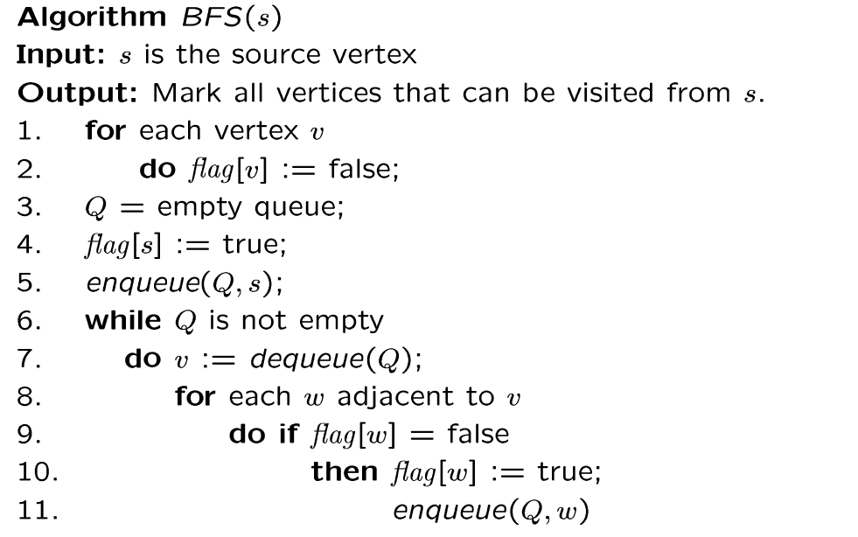
BSF algorithm
Why use queue? Need FIFO

Slide 19
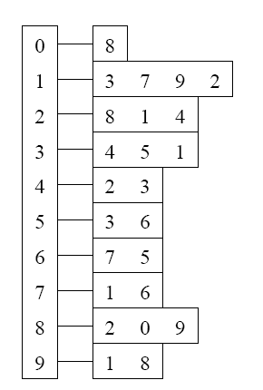
Example
Adjacency List
Visited Table (T/F)
0
1
2
3
4
5
6
7
8
9
F
F
F
F
F
F
F
F
F
F
0
8
source
2
9
1
3
7
6
4
5
Initialize visited
table (all False)
Q =
{ }
Initialize Q to be empty

Slide 20
Example
Adjacency List
Visited Table (T/F)
0
1
2
3
4
5
6
7
8
9
F
F
T
F
F
F
F
F
F
F
0
8
source
2
9
1
3
7
6
4
5
Flag that 2 has
been visited.
Q =
{ 2 }
Place source 2 on the queue.

Slide 21
Example
Adjacency List
Visited Table (T/F)
0
1
2
3
4
5
6
7
8
9
F
T
T
F
T
F
F
F
T
F
0
8
Neighbors
source
2
9
1
3
7
6
4
5
Mark neighbors
as visited.
Q =
{2} → { 8, 1, 4 }
Dequeue 2.
Place all unvisited neighbors of 2 on the queue

Slide 22
Example
Adjacency List
Visited Table (T/F)
0
1
2
3
4
5
6
7
8
9
T
T
T
F
T
F
F
F
T
T
0
8
source
2
9
1
3
7
Neighbors
6
4
5
Mark new visited
Neighbors.
Q =
{ 8, 1, 4 } → { 1, 4, 0, 9 }
Dequeue 8.
-- Place all unvisited neighbors of 8 on the queue.
-- Notice that 2 is not placed on the queue again, it has been visited!

Slide 23
Example
Adjacency List
Visited Table (T/F)
0
1
2
3
4
5
6
7
8
9
T
T
T
T
T
F
F
T
T
T
0
Neighbors
8
source
2
9
1
3
7
6
4
5
Mark new visited
Neighbors.
Q =
{ 1, 4, 0, 9 } → { 4, 0, 9, 3, 7 }
Dequeue 1.
-- Place all unvisited neighbors of 1 on the queue.
-- Only nodes 3 and 7 haven’t been visited yet.

Slide 24
Example
Adjacency List
Visited Table (T/F)
0
1
2
3
4
5
6
7
8
9
T
T
T
T
T
F
F
T
T
T
0
8
source
2
9
Neighbors
1
3
7
6
4
5
Q =
{ 4, 0, 9, 3, 7 } → { 0, 9, 3, 7 }
Dequeue 4.
-- 4 has no unvisited neighbors!

Slide 25
Example
Adjacency List
Visited Table (T/F)
Neighbors
0
1
2
3
4
5
6
7
8
9
T
T
T
T
T
F
F
T
T
T
0
8
source
2
9
1
3
7
6
4
5
Q =
{ 0, 9, 3, 7 } → { 9, 3, 7 }
Dequeue 0.
-- 0 has no unvisited neighbors!

Slide 26
Example
Adjacency List
Visited Table (T/F)
0
1
2
3
4
5
6
7
8
9
T
T
T
T
T
F
F
T
T
T
0
8
source
2
9
1
3
7
6
4
5
Neighbors
Q =
{ 9, 3, 7 } → { 3, 7 }
Dequeue 9.
-- 9 has no unvisited neighbors!

Slide 27
Example
Adjacency List
Visited Table (T/F)
0
1
2
3
4
5
6
7
8
9
T
T
T
T
T
T
F
T
T
T
0
8
Neighbors
source
2
9
1
3
7
6
4
5
Mark new visited
Vertex 5.
Q =
{ 3, 7 } → { 7, 5 }
Dequeue 3.
-- place neighbor 5 on the queue.

Slide 28
Example
Adjacency List
Visited Table (T/F)
0
1
2
3
4
5
6
7
8
9
T
T
T
T
T
T
T
T
T
T
0
8
source
2
9
1
7
Neighbors
3
6
4
5
Mark new visited
Vertex 6.
Q =
{ 7, 5 } → { 5, 6 }
Dequeue 7.
-- place neighbor 6 on the queue.

Slide 29
Example
Adjacency List
Visited Table (T/F)
0
1
2
3
4
5
6
7
8
9
T
T
T
T
T
T
T
T
T
T
0
8
source
2
9
Neighbors
1
3
7
6
4
5
Q =
{ 5, 6} → { 6 }
Dequeue 5.
-- no unvisited neighbors of 5.

Slide 30
Example
Adjacency List
Visited Table (T/F)
0
1
2
3
4
5
6
7
8
9
T
T
T
T
T
T
T
T
T
T
0
8
source
2
9
1
Neighbors
3
7
6
4
5
Q =
{ 6 } → { }
Dequeue 6.
-- no unvisited neighbors of 6.

Slide 31
Example
Adjacency List
Visited Table (T/F)
0
1
2
3
4
5
6
7
8
9
T
T
T
T
T
T
T
T
T
T
0
8
source
2
9
1
3
7
6
4
5
What did we discover?
Look at “visited” tables.
There exists a path from source
vertex 2 to all vertices in the graph.
Q =
{ }
STOP!!! Q is empty!!!

Slide 32
Time Complexity of BFS
(Using adjacency list)
Assume adjacency list
  n = number of vertices m = number of edges
O(n + m)
Each vertex will enter Q at most once.
Each iteration takes time proportional to deg(v) + 1 (the number 1 is to include the case where deg(v) = 0).

Slide 33
Running time
Given a graph with m edges, what is the total degree?
The total running time of the while loop is:
this is summing over all the iterations in the while loop!
Σ_{vertex v} deg(v) = 2m
O( Σ_{vertex v} (deg(v) + 1) ) = O(n+m)

Slide 34
Time Complexity of BFS
(Using adjacency matrix)
Assume adjacency list
  n = number of vertices m = number of edges
O(n²)
Finding the adjacent vertices of v requires checking all elements in the row. This takes linear time O(n).
Summing over all the n iterations, the total running time is O(n²).
So, with adjacency matrix, BFS is O(n²) independent of number of edges m.
With adjacent lists, BFS is O(n+m); if m=O(n²) like a dense graph, O(n+m)=O(n²).

Slide 35
Shortest Path Recording
BFS we saw only tells us whether a path exists from source s, to other vertices v.
  It doesn’t tell us the path!
  We need to modify the algorithm to record the path.
How can we do that?
  Note: we do not know which vertices lie on this path until we reach v!
  Efficient solution:
    Use an additional array pred[0..n-1]
    Pred[w] = v means that vertex w was visited from v

Slide 36
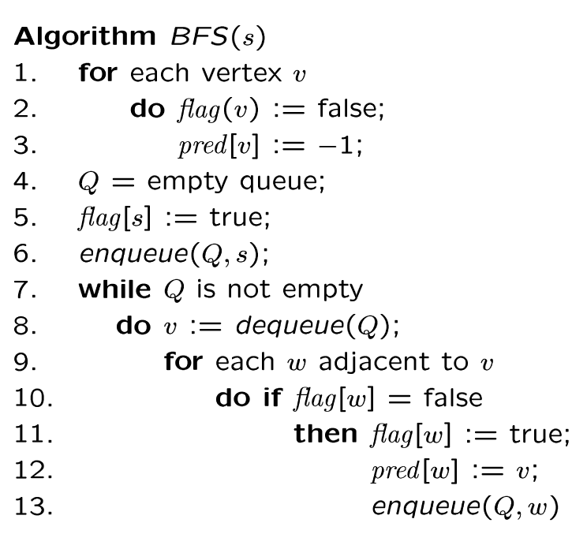
BFS + Path Finding
initialize all pred[v] to -1
Record where you came from

Slide 37
Example
Adjacency List
Visited Table (T/F)
0
1
2
3
4
5
6
7
8
9
F
F
F
F
F
F
F
F
F
F
-
-
-
-
-
-
-
-
-
-
0
8
source
2
9
1
3
7
6
4
5
Pred
Initialize visited
table (all False)
Initialize Pred to -1
Q =
{ }
Initialize Q to be empty

Slide 38
Example
Adjacency List
Visited Table (T/F)
0
1
2
3
4
5
6
7
8
9
F
F
T
F
F
F
F
F
F
F
-
-
-
-
-
-
-
-
-
-
0
8
source
2
9
1
3
7
6
4
5
Pred
Flag that 2 has
been visited.
Q =
{ 2 }
Place source 2 on the queue.

Slide 39
Example
Adjacency List
Visited Table (T/F)
0
1
2
3
4
5
6
7
8
9
F
T
T
F
T
F
F
F
T
F
-
2
-
-
2
-
-
-
2
-
0
8
Neighbors
source
2
9
1
3
7
6
4
5
Pred
Mark neighbors
as visited.
Record in Pred
that we came from 2.
Q =
{2} → { 8, 1, 4 }
Dequeue 2.
Place all unvisited neighbors of 2 on the queue

Slide 40
Example
Adjacency List
Visited Table (T/F)
0
1
2
3
4
5
6
7
8
9
T
T
T
F
T
F
F
F
T
T
8
2
-
-
2
-
-
-
2
8
0
8
source
2
9
1
3
7
Neighbors
6
4
5
Pred
Mark new visited
Neighbors.
Record in Pred
that we came
from 8.
Q =
{ 8, 1, 4 } → { 1, 4, 0, 9 }
Dequeue 8.
-- Place all unvisited neighbors of 8 on the queue.
-- Notice that 2 is not placed on the queue again, it has been visited!

Slide 41
Example
Adjacency List
Visited Table (T/F)
0
1
2
3
4
5
6
7
8
9
T
T
T
T
T
F
F
T
T
T
8
2
-
1
2
-
-
1
2
8
0
Neighbors
8
source
2
9
1
3
7
6
4
5
Pred
Mark new visited
Neighbors.
Record in Pred
that we came
from 1.
Q =
{ 1, 4, 0, 9 } → { 4, 0, 9, 3, 7 }
Dequeue 1.
-- Place all unvisited neighbors of 1 on the queue.
-- Only nodes 3 and 7 haven’t been visited yet.

Slide 42
Example
Adjacency List
Visited Table (T/F)
0
1
2
3
4
5
6
7
8
9
T
T
T
T
T
F
F
T
T
T
8
2
-
1
2
-
-
1
2
8
0
8
2
Neighbors
source
9
1
3
7
6
4
5
Pred
Q =
{ 4, 0, 9, 3, 7 } → { 0, 9, 3, 7 }
Dequeue 4.
-- 4 has no unvisited neighbors!

Slide 43
Example
Adjacency List
Visited Table (T/F)
Neighbors
0
1
2
3
4
5
6
7
8
9
T
T
T
T
T
F
F
T
T
T
8
2
-
1
2
-
-
1
2
8
0
8
source
2
9
1
3
7
6
4
5
Pred
Q =
{ 0, 9, 3, 7 } → { 9, 3, 7 }
Dequeue 0.
-- 0 has no unvisited neighbors!

Slide 44
Example
Adjacency List
Visited Table (T/F)
0
1
2
3
4
5
6
7
8
9
T
T
T
T
T
F
F
T
T
T
8
2
-
1
2
-
-
1
2
8
0
8
source
2
9
1
3
7
6
4
5
Neighbors
Pred
Q =
{ 9, 3, 7 } → { 3, 7 }
Dequeue 9.
-- 9 has no unvisited neighbors!

Slide 45
Example
Adjacency List
Visited Table (T/F)
0
1
2
3
4
5
6
7
8
9
T
T
T
T
T
T
F
T
T
T
8
2
-
1
2
3
-
1
2
8
0
8
Neighbors
source
2
9
1
3
7
6
4
5
Pred
Mark new visited
Vertex 5.
Record in Pred
that we came
from 3.
Q =
{ 3, 7 } → { 7, 5 }
Dequeue 3.
-- place neighbor 5 on the queue.

Slide 46
Example
Adjacency List
Visited Table (T/F)
0
1
2
3
4
5
6
7
8
9
T
T
T
T
T
T
T
T
T
T
8
2
-
1
2
3
7
1
2
8
0
8
source
2
9
1
7
Neighbors
3
6
4
5
Pred
Mark new visited
Vertex 6.
Record in Pred
that we came
from 7.
Q =
{ 7, 5 } → { 5, 6 }
Dequeue 7.
-- place neighbor 6 on the queue.

Slide 47
Example
Adjacency List
Visited Table (T/F)
0
1
2
3
4
5
6
7
8
9
T
T
T
T
T
T
T
T
T
T
8
2
-
1
2
3
7
1
2
8
0
8
source
2
9
Neighbors
1
3
7
6
4
5
Pred
Q =
{ 5, 6} → { 6 }
Dequeue 5.
-- no unvisited neighbors of 5.

Slide 48
Example
Adjacency List
Visited Table (T/F)
0
1
2
3
4
5
6
7
8
9
T
T
T
T
T
T
T
T
T
T
8
2
-
1
2
3
7
1
2
8
0
8
source
2
9
1
Neighbors
3
7
6
4
5
Pred
Q =
{ 6 } → { }
Dequeue 6.
-- no unvisited neighbors of 6.

Slide 49
Example
Adjacency List
Visited Table (T/F)
0
1
2
3
4
5
6
7
8
9
T
T
T
T
T
T
T
T
T
T
8
2
-
1
2
3
7
1
2
8
0
8
source
2
9
1
3
7
6
4
5
Pred
Pred now can be traced backward
to report the path!
Q =
{ }
STOP!!! Q is empty!!!

Slide 50
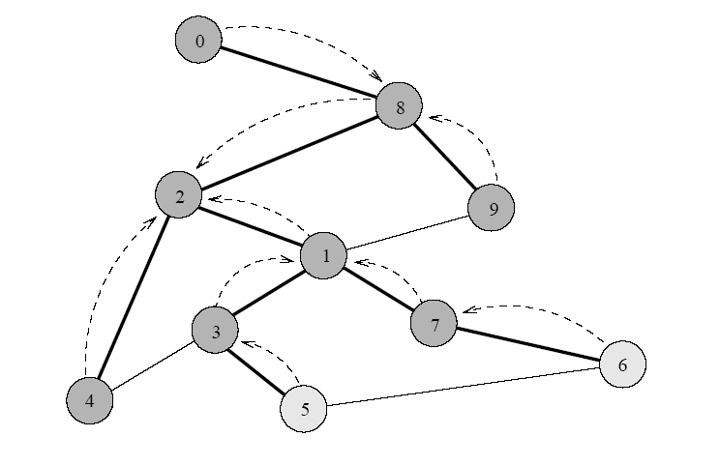
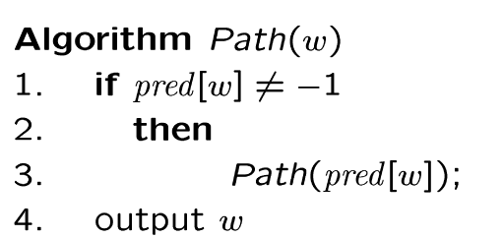
Path reporting
nodes
visited from
0
1
2
3
4
5
6
7
8
9
8
2
-
1
2
3
7
1
2
8
Try some examples, report path from s to v:
Path(0) ->
Path(6) ->
Path(1) ->
The path returned is the shortest from s to v (minimum number of edges).

Slide 51
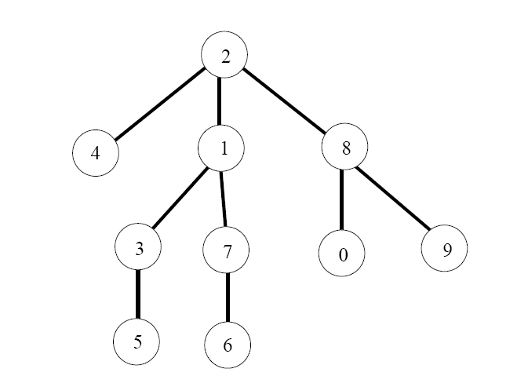
BFS tree
The paths found by BFS is often drawn as a rooted tree (called BFS tree), with the starting vertex as the root of the tree.
BFS tree for vertex s=2.
Question: What would a “level” order traversal tell you?

Slide 52
How do we record the shortest distances?
d(v) = ∞;
d(s) = 0;
d(w)=d(v)+1;

Slide 53
Application of BFS
One application concerns how to find
connected components in a graph
If a graph has more than one connected components, BFS builds a BFS-forest (not just BFS-tree)!
  Each tree in the forest is a connected component.

